Slide 1
StudentSavvy © 2015

Slide 2
Teacher Info Cards Freebie!
thank you for downloading!
**PLEASE READ: This product is editable. This version will NOT have custom fonts. If you would like to edit the custom fonts, you must download them using the links below. Remember, without the fonts the PowerPoint file will not like the preview photos
CLICK to download custom fonts - Short Stack, , Digs My Heart, KG Two is Better Than One, KG Payphone, Wish I Were Taller
StudentSavvy © 2015
Thank you for downloading StudentSavvy’s Teacher Info Cards Freebie! If you have any questions regarding this product, please email me at studentsavvyontpt@gmail.com
Be sure to stay updated and follow for the latest
freebies and giveaways!
studentsavvyontpt.blogspot.com
www.facebook.com/studentsavvy
www.pinterest.com/studentsavvy
wwww.teacherspayteachers.com/store/studentsavvy
- CREDIT -
borders by Glitter Meets Glue
fonts by Kevin & Amanda Fonts
Kimberly Geswein
clipart purchased and downloaded from:
Dollar Photo Club

Slide 3
Mrs. Escobar
Transformation Math Coach
Cutler Bay Middle School
Mrs. Escobar
Office Hours – 8:30AM-3:50PM
Email – ddescobar@dadeschools.net
Phone Number – 305*878*2352
Teacher Information Cards
Mrs. Escobar
Mrs. Escobar
Transformation Math Coach
Cutler Bay Middle School
Transformation Math Coach
Cutler Bay Middle School
Office Hours – 8:30AM-3:50PM
Email – ddescobar@dadeschools.net
Phone Number – 305*878*2352
Office Hours – 8:30AM-3:50PM
Email – ddescobar@dadeschools.net
Phone Number – 305*878*2352
StudentSavvy © 2015

Slide 4
Thanks for
downloading!
All rights reserved by StudentSavvy. Permission to copy for SINGLE classroom use only. If you would like to share this product with other educators, you MUST purchase a multiple license. You may not
alter this PDF in any way or resell. Copying any part of this product and placing it on the internet in any form is strictly forbidden and is a violation of the Digital Millennium Copyright Act (DMCA). These items will be located by Google and traced back to the publishing site.
StudentSavvy © 2015

Slide 5
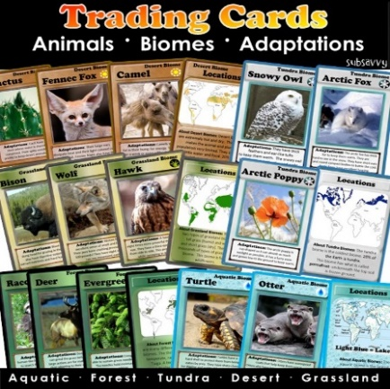
Studentsavvy
“Where teachers become savvy about their students, finding the latest information and resources to use in the classroom!”
CLICK HERE TO FOLLOW AND FIND ADDITIONAL RESOURCES!
StudentSavvy © 2015
Photo Credit – Dollar Photo Club

