Slide 1
StudentSavvy © 2015

Slide 2
Information
Pamphlet
thank you for downloading!
**PLEASE READ: This product is editable. This version will NOT have custom fonts. If you would like to edit the custom fonts, you must download them using the links below. Remember, without the fonts the PowerPoint file will not like the preview photos. MAKE SURE TO RIGHT CLICK EACH FONT AND CLICK OPEN HYPERLINK!
CLICK to download custom fonts -,Short Stack , Digs My Heart, KG Two is Better Than One, KG Payphone, Wish I Were Taller
StudentSavvy © 2015
Thank you for downloading StudentSavvy’s Information Pamphlet! If you have any questions regarding this product, please email me at studentsavvyontpt@gmail.com
Be sure to stay updated and follow for the latest
freebies and giveaways!
studentsavvyontpt.blogspot.com
www.facebook.com/studentsavvy
www.pinterest.com/studentsavvy
wwww.teacherspayteachers.com/store/studentsavvy
- CREDIT -
borders by Glitter Meets Glue
fonts by Kevin & Amanda Fonts
Kimberly Geswein
clipart by Paula Kim Studio
clipart purchased and downloaded from:
Dollar Photo Club

Slide 3
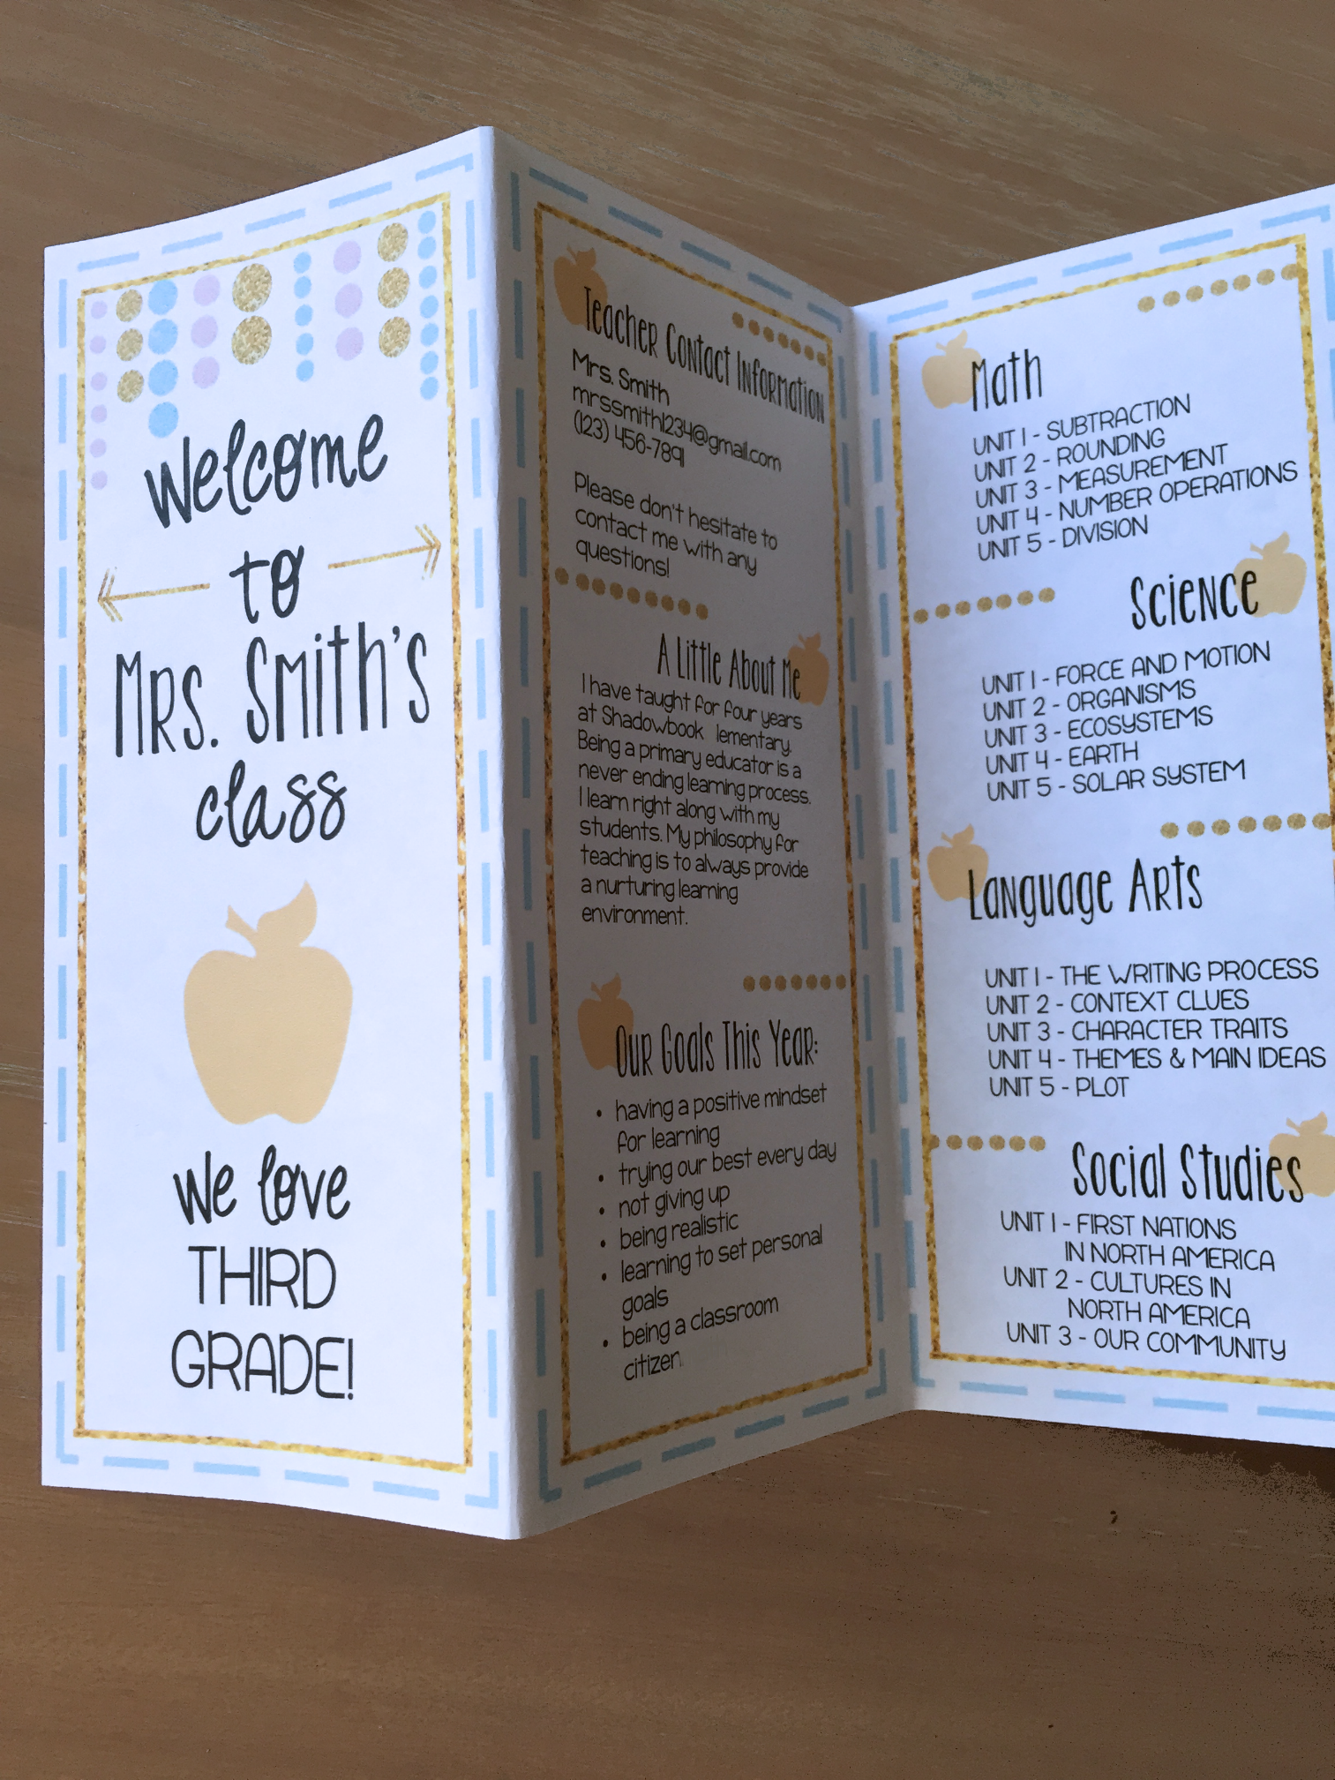
Sample image of organizational pamphlet on next page.
Edit the text to best fit your needs. Just print and fold into thirds!
StudentSavvy © 2015

Slide 4
Welcome
to
Mrs. Escobar’s
class
Office Hours – 8:30AM-3:50PM
Email – ddescobar@dadeschools.net
Phone Number – 305*878*2352
Study 30-60 minutes daily
Complete all assignments and turn in on due date
Come to class prepared
Ask questions and participate
I have 20+ years experience in education; 5 as an administrator. I currently hold a BS in Sports Medicine and a MS in Educational Leadership. I believe in my students and push them to accomplish more than they ever thought they could.
A Little About Me
Mrs. Escobar
Transformation Math Coach
Contact Information
Keys to Success
Let Your Dreams Be Your Wings
PHOTOSYNTHESIS
CELLULAR RESPIRATION
STIMULUS
TROPISM
PLANT HORMONES
ABIOTIC FACTORS
CYCLES OF MATTER
ENERGY IN ECOSYSTEMS
SUN-EARTHMOON SYSTEM
THE SOLAR SYSTEM
STARS & GALAXIES
THE SUN
METEORS, COMETS, & ASTEROIDS
PROPERTIES OF MATTER
ATOMS
PERIODIC TABLE
CHEMICAL BONDS
ACIDS & BASES
CHEMIICAL REACTIONS
CHEMICAL EQUATIONS
SCIENTIFIC INQUIRY SCIENTIFIC TOOLS
LAB SAFETY
MEASUREMENT
INTERNATIONAL SYSTEM OF UNITS
SCIENTIFIC NOTATION
Earth Science
Life Science
The Number System
Ratios & Proportions
StudentSavvy © 2015

Slide 5
Thanks for
downloading!
All rights reserved by StudentSavvy. Permission to copy for SINGLE classroom use only. If you would like to share this product with other educators, you MUST purchase a multiple license. You may not
alter this PDF in any way or resell. Copying any part of this product and placing it on the internet in any form is strictly forbidden and is a violation of the Digital Millennium Copyright Act (DMCA). These items will be located by Google and traced back to the publishing site.
StudentSavvy © 2015

Slide 6
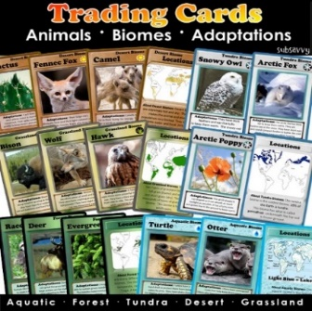
Studentsavvy
“Where teachers become savvy about their students, finding the latest information and resources to use in the classroom!”
CLICK HERE TO FOLLOW AND FIND ADDITIONAL RESOURCES!
StudentSavvy © 2015
Photo Credit – Dollar Photo Club

